Slide 1
What is Cluster Analysis?
Finding groups of objects such that the objects in a group will be similar (or related) to one another and different from (or unrelated to) the objects in other groups
Inter-cluster distances are maximized
Intra-cluster distances are minimized

Slide 2
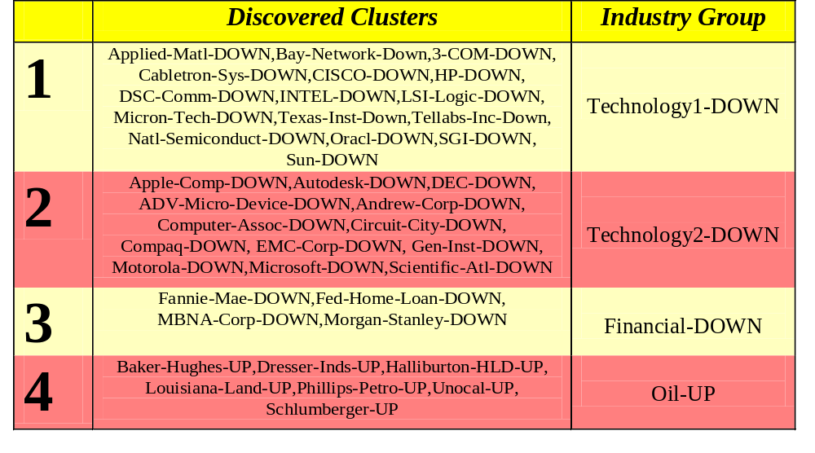
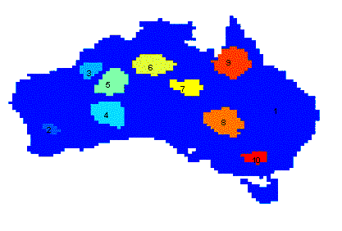
Applications of Cluster Analysis
Understanding
  Group related documents for browsing, group genes and proteins that have similar functionality, or group stocks with similar price fluctuations
Summarization
  Reduce the size of large data sets
Clustering precipitation in Australia

Slide 3
What is not Cluster Analysis?
Supervised classification
  Have class label information
Simple segmentation
  Dividing students into different registration groups alphabetically, by last name
Results of a query
  Groupings are a result of an external specification
Graph partitioning
  Some mutual relevance and synergy, but areas are not identical

Slide 4
Notion of a Cluster can be Ambiguous
How many clusters?
Six Clusters
Two Clusters
Four Clusters

Slide 5
Types of Clusterings
A clustering is a set of clusters
Important distinction between hierarchical and partitional sets of clusters
Partitional Clustering
  A division data objects into non-overlapping subsets (clusters) such that each data object is in exactly one subset
Hierarchical clustering
  A set of nested clusters organized as a hierarchical tree

Slide 6

Partitional Clustering
Original Points
A Partitional Clustering

Slide 7
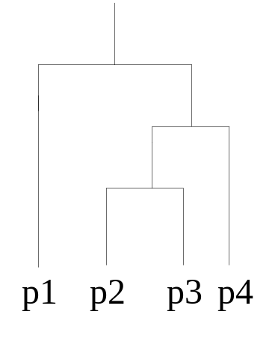
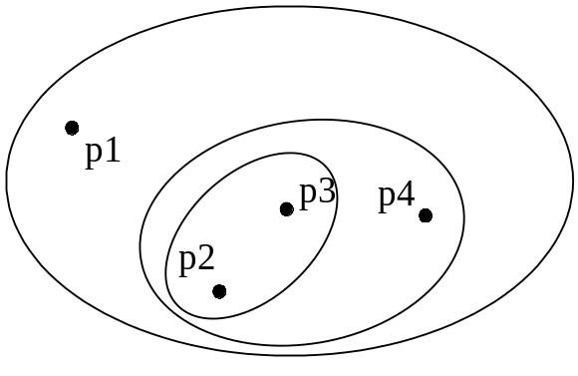
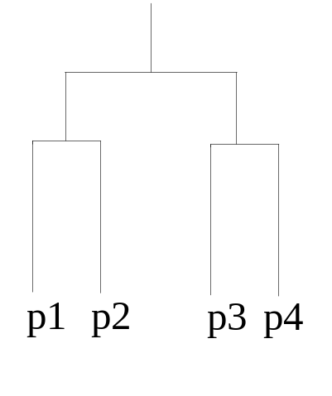
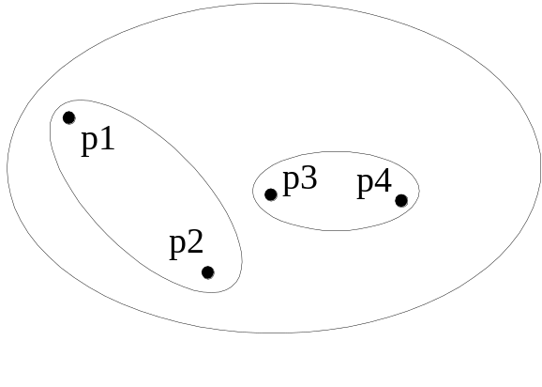
Hierarchical Clustering
Traditional Hierarchical Clustering
Traditional Dendrogram
Non-traditional Hierarchical Clustering
Non-traditional Dendrogram

Slide 8
Other Distinctions Between Sets of Clusters
Exclusive versus non-exclusive
  In non-exclusive clusterings, points may belong to multiple clusters.
  Can represent multiple classes or ‘border’ points
Fuzzy versus non-fuzzy
  In fuzzy clustering, a point belongs to every cluster with some weight between 0 and 1
  Weights must sum to 1
  Probabilistic clustering has similar characteristics
Partial versus complete
  In some cases, we only want to cluster some of the data
Heterogeneous versus homogeneous
  Cluster of widely different sizes, shapes, and densities

Slide 9
Types of Clusters
Well-separated clusters
Center-based clusters
Contiguous clusters
Density-based clusters
Property or Conceptual
Described by an Objective Function

Slide 10
Types of Clusters: Well-Separated
Well-Separated Clusters:
  A cluster is a set of points such that any point in a cluster is closer (or more similar) to every other point in the cluster than to any point not in the cluster.
3 well-separated clusters

Slide 11
Types of Clusters: Center-Based
Center-based
  A cluster is a set of objects such that an object in a cluster is closer (more similar) to the “center” of a cluster, than to the center of any other cluster
  The center of a cluster is often a centroid, the average of all the points in the cluster, or a medoid, the most “representative” point of a cluster
4 center-based clusters

Slide 12
Types of Clusters: Contiguity-Based
Contiguous Cluster (Nearest neighbor or Transitive)
  A cluster is a set of points such that a point in a cluster is closer (or more similar) to one or more other points in the cluster than to any point not in the cluster.
8 contiguous clusters

Slide 13
Types of Clusters: Density-Based
Density-based
  A cluster is a dense region of points, which is separated by low-density regions, from other regions of high density.
  Used when the clusters are irregular or intertwined, and when noise and outliers are present.
6 density-based clusters

Slide 14
Types of Clusters: Conceptual Clusters
Shared Property or Conceptual Clusters
  Finds clusters that share some common property or represent a particular concept.
  .
2 Overlapping Circles

Slide 15
Types of Clusters: Objective Function
Clusters Defined by an Objective Function
  Finds clusters that minimize or maximize an objective function.
  Enumerate all possible ways of dividing the points into clusters and evaluate the `goodness' of each potential set of clusters by using the given objective function. (NP Hard)
  Can have global or local objectives.
    Hierarchical clustering algorithms typically have local objectives
    Partitional algorithms typically have global objectives
  A variation of the global objective function approach is to fit the data to a parameterized model.
    Parameters for the model are determined from the data.
    Mixture models assume that the data is a ‘mixture' of a number of statistical distributions.

Slide 16
Types of Clusters: Objective Function …
Map the clustering problem to a different domain and solve a related problem in that domain
  Proximity matrix defines a weighted graph, where the nodes are the points being clustered, and the weighted edges represent the proximities between points
  Clustering is equivalent to breaking the graph into connected components, one for each cluster.
  Want to minimize the edge weight between clusters and maximize the edge weight within clusters

Slide 17
Characteristics of the Input Data Are Important
Type of proximity or density measure
  This is a derived measure, but central to clustering
Sparseness
  Dictates type of similarity
  Adds to efficiency
Attribute type
  Dictates type of similarity
Type of Data
  Dictates type of similarity
  Other characteristics, e.g., autocorrelation
Dimensionality
Noise and Outliers
Type of Distribution

Slide 18


Data Structures
Data matrix
  (two modes)
Dissimilarity matrix
  (one mode)

Slide 19
Type of data in clustering analysis
Interval-scaled variables
Binary variables
Nominal, ordinal, and ratio variables
Variables of mixed types

Slide 20


Interval-valued variables
Standardize data
  Calculate the mean absolute deviation:
  where
  Calculate the standardized measurement (z-score)
Using mean absolute deviation is more robust than using standard deviation

Slide 21


Similarity and Dissimilarity Between Objects
Distances are normally used to measure the similarity or dissimilarity between two data objects
Some popular ones include: Minkowski distance:
  where i = (x_{i1}, x_{i2}, …, x_{ip}) and j = (x_{j1}, x_{j2}, …, x_{jp}) are two p-dimensional data objects, and q is a positive integer
If q = 1, d is Manhattan distance

Slide 22

Similarity and Dissimilarity Between Objects (Cont.)
If q = 2, d is Euclidean distance:
  Properties
    d(i,j) ≥ 0
    d(i,i) = 0
    d(i,j) = d(j,i)
    d(i,j) ≤ d(i,k) + d(k,j)
Also, one can use weighted distance, parametric Pearson product moment correlation, or other disimilarity measures

Slide 23


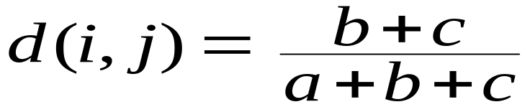
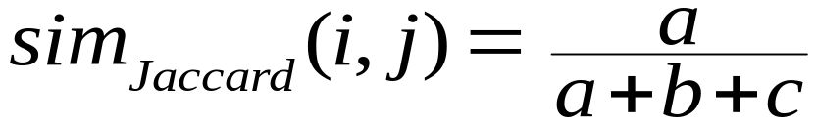
Binary Variables
Object j
A contingency table for binary data
Distance measure for symmetric binary variables:
Distance measure for asymmetric binary variables:
Jaccard coefficient (similarity measure for asymmetric binary variables):
Object i

Slide 24


Dissimilarity between Binary Variables
Example
  gender is a symmetric attribute
  the remaining attributes are asymmetric binary
  let the values Y and P be set to 1, and the value N be set to 0

Slide 25

Nominal Variables
A generalization of the binary variable in that it can take more than 2 states, e.g., red, yellow, blue, green
Method 1: Simple matching
  m: # of matches, p: total # of variables
Method 2: use a large number of binary variables
  creating a new binary variable for each of the M nominal states

Slide 26


Ordinal Variables
An ordinal variable can be discrete or continuous
Order is important, e.g., rank
Can be treated like interval-scaled
  replace x_{if} by their rank
  map the range of each variable onto [0, 1] by replacing i-th object in the f-th variable by
  compute the dissimilarity using methods for interval-scaled variables

Slide 27
Ratio-Scaled Variables
Ratio-scaled variable: a positive measurement on a nonlinear scale, approximately at exponential scale, such as Ae^{Bt} or Ae^{-Bt}
Methods:
  treat them like interval-scaled variables—not a good choice! (why?—the scale can be distorted)
  apply logarithmic transformation
y_{if} = log(x_{if})
  treat them as continuous ordinal data treat their rank as interval-scaled

Slide 28


Variables of Mixed Types
A database may contain all the six types of variables
  symmetric binary, asymmetric binary, nominal, ordinal, interval and ratio
One may use a weighted formula to combine their effects
  f is binary or nominal:
    d_{ij}^{(f)} = 0 if x_{if} = x_{jf} , or d_{ij}^{(f)} = 1 otherwise
  f is interval-based: use the normalized distance
  f is ordinal or ratio-scaled
    compute ranks r_{if} and
    and treat z_{if} as interval-scaled

Slide 29


Vector Objects
Vector objects: keywords in documents, gene features in micro-arrays, etc.
Broad applications: information retrieval, biologic taxonomy, etc.
Cosine measure
A variant: Tanimoto coefficient

Slide 30
Clustering Algorithms
K-means and its variants
Hierarchical clustering
Density-based clustering

Slide 31

K-means Clustering
Partitional clustering approach
Each cluster is associated with a centroid (center point)
Each point is assigned to the cluster with the closest centroid
Number of clusters, K, must be specified
The basic algorithm is very simple

Slide 32
K-means Clustering – Details
Initial centroids are often chosen randomly.
  Clusters produced vary from one run to another.
The centroid is (typically) the mean of the points in the cluster.
‘Closeness’ is measured by Euclidean distance, cosine similarity, correlation, etc.
K-means will converge for common similarity measures mentioned above.
Most of the convergence happens in the first few iterations.
  Often the stopping condition is changed to ‘Until relatively few points change clusters’
Complexity is O( n * K * I * d )
  n = number of points, K = number of clusters,
  I = number of iterations, d = number of attributes

Slide 33



Two different K-means Clusterings
Original Points
Optimal Clustering
Sub-optimal Clustering

Slide 34






Importance of Choosing Initial Centroids

Slide 35
Importance of Choosing Initial Centroids

Slide 36
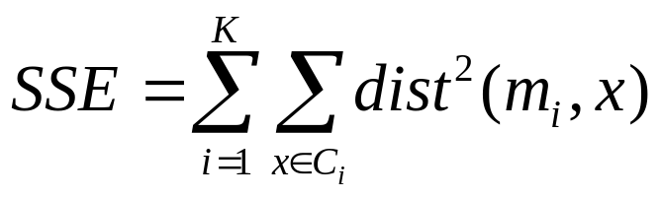
Evaluating K-means Clusters
Most common measure is Sum of Squared Error (SSE)
  For each point, the error is the distance to the nearest cluster
  To get SSE, we square these errors and sum them.
  x is a data point in cluster C_{i} and m_{i} is the representative point for cluster C_{i}
    can show that m_{i} corresponds to the center (mean) of the cluster
  Given two clusters, we can choose the one with the smallest error
  One easy way to reduce SSE is to increase K, the number of clusters
    A good clustering with smaller K can have a lower SSE than a poor clustering with higher K

Slide 37
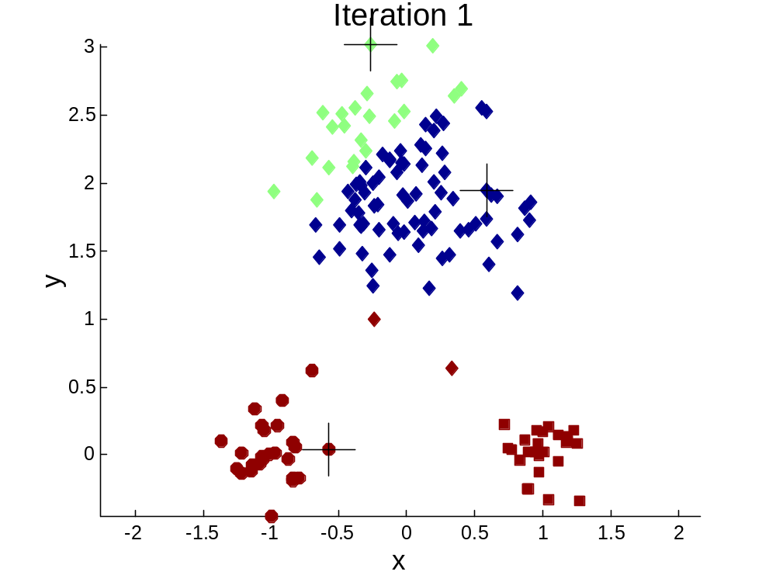


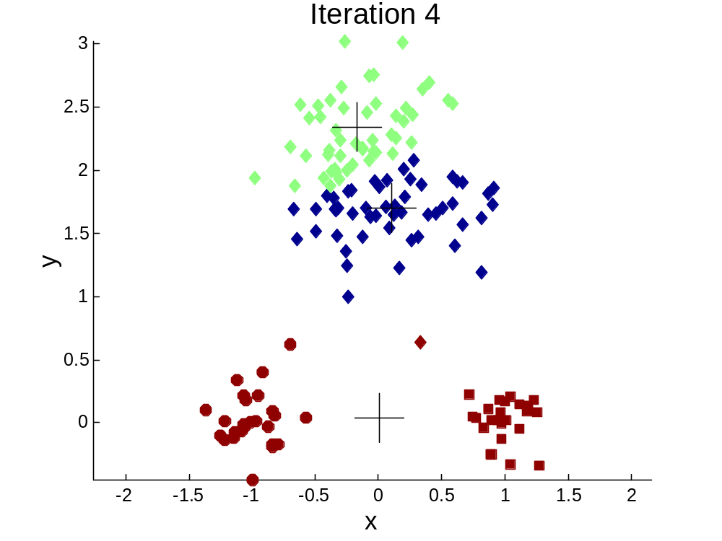
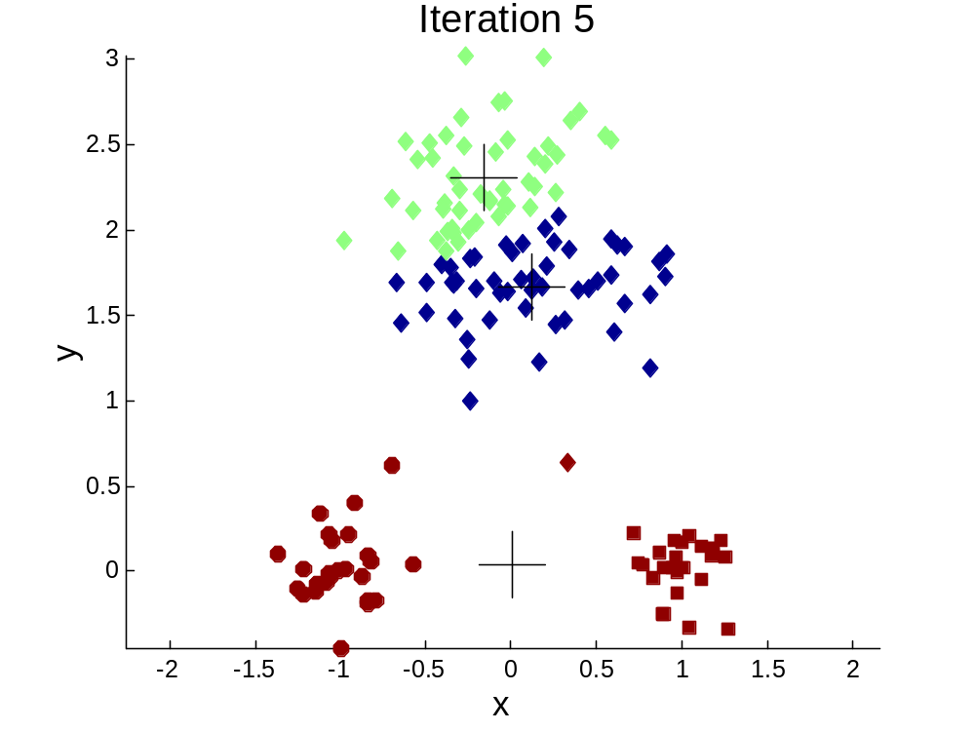
Importance of Choosing Initial Centroids …

Slide 38
Importance of Choosing Initial Centroids …

Slide 39
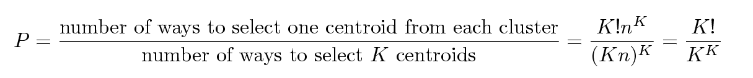
Problems with Selecting Initial Points
If there are K ‘real’ clusters then the chance of selecting one centroid from each cluster is small.
  Chance is relatively small when K is large
  If clusters are the same size, n, then
  For example, if K = 10, then probability = 10!/10¹⁰ = 0.00036
  Sometimes the initial centroids will readjust themselves in ‘right’ way, and sometimes they don’t
  Consider an example of five pairs of clusters

Slide 40
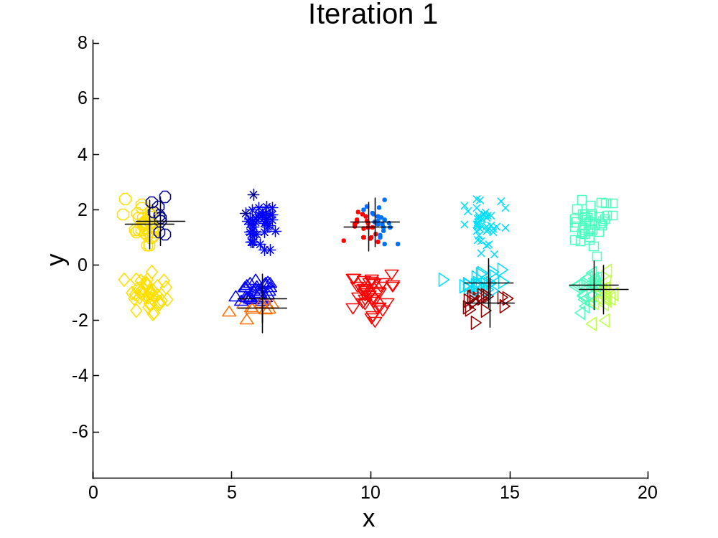
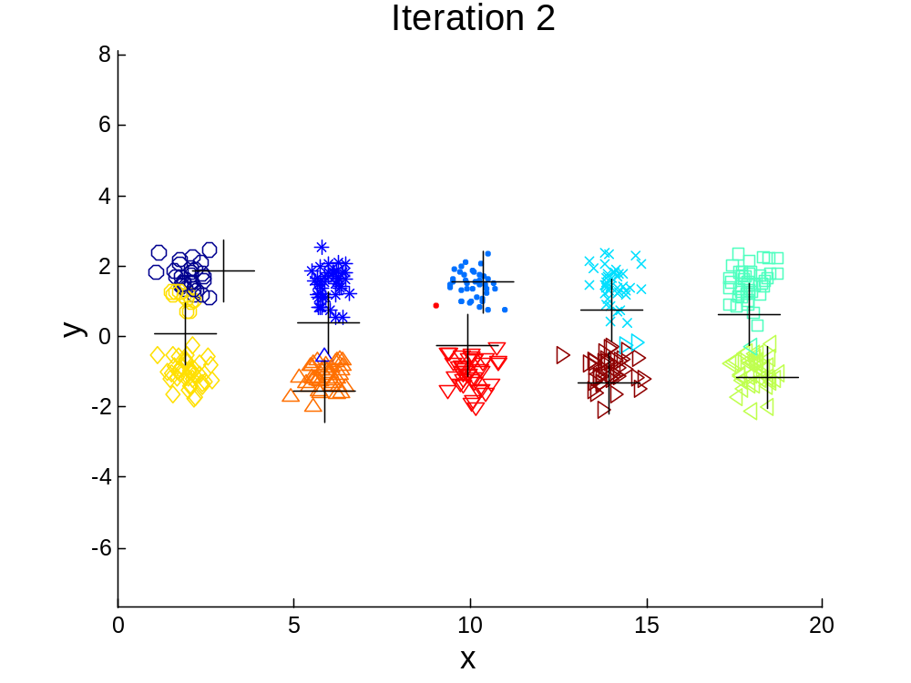
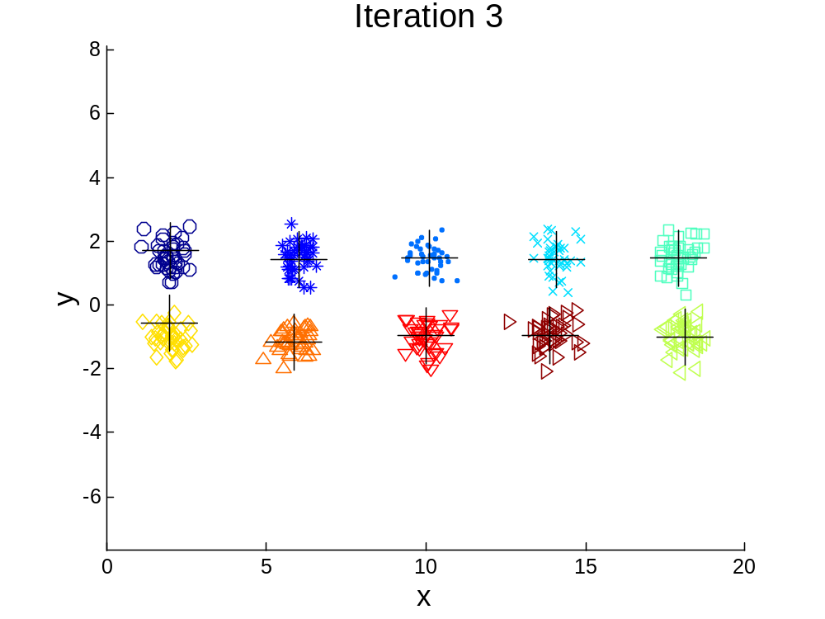

10 Clusters Example
Starting with two initial centroids in one cluster of each pair of clusters

Slide 41
10 Clusters Example
Starting with two initial centroids in one cluster of each pair of clusters

Slide 42
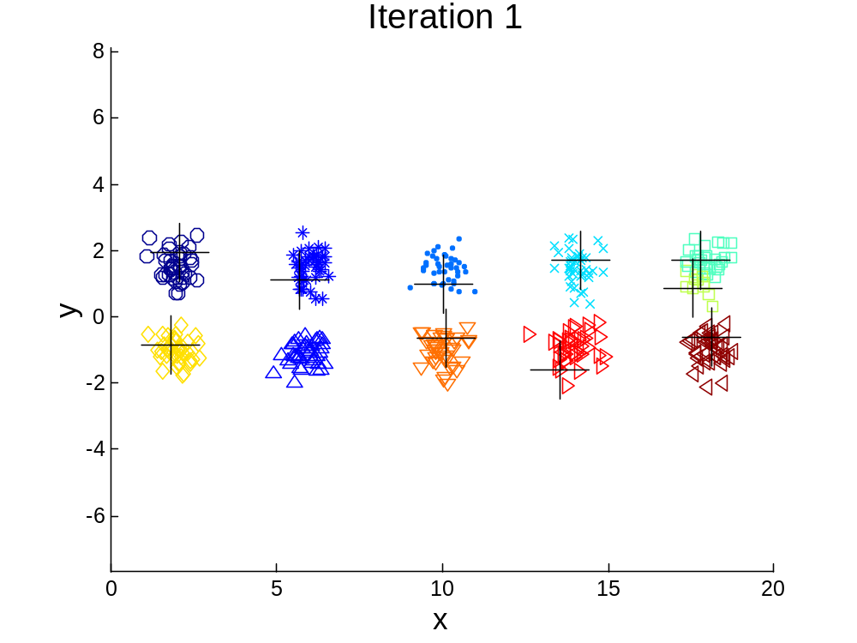



10 Clusters Example
Starting with some pairs of clusters having three initial centroids, while other have only one.

Slide 43
10 Clusters Example
Starting with some pairs of clusters having three initial centroids, while other have only one.

Slide 44
Solutions to Initial Centroids Problem
Multiple runs
  Helps, but probability is not on your side
Sample and use hierarchical clustering to determine initial centroids
Select more than k initial centroids and then select among these initial centroids
  Select most widely separated
Postprocessing
Bisecting K-means
  Not as susceptible to initialization issues

Slide 45
Handling Empty Clusters
Basic K-means algorithm can yield empty clusters
Several strategies
  Choose the point that contributes most to SSE
  Choose a point from the cluster with the highest SSE
  If there are several empty clusters, the above can be repeated several times.

Slide 46
Updating Centers Incrementally
In the basic K-means algorithm, centroids are updated after all points are assigned to a centroid
An alternative is to update the centroids after each assignment (incremental approach)
  Each assignment updates zero or two centroids
  More expensive
  Introduces an order dependency
  Never get an empty cluster
  Can use “weights” to change the impact

Slide 47
Pre-processing and Post-processing
Pre-processing
  Normalize the data
  Eliminate outliers
Post-processing
  Eliminate small clusters that may represent outliers
  Split ‘loose’ clusters, i.e., clusters with relatively high SSE
  Merge clusters that are ‘close’ and that have relatively low SSE
  Can use these steps during the clustering process
    ISODATA

Slide 48

Bisecting K-means
Bisecting K-means algorithm
  Variant of K-means that can produce a partitional or a hierarchical clustering

Slide 49
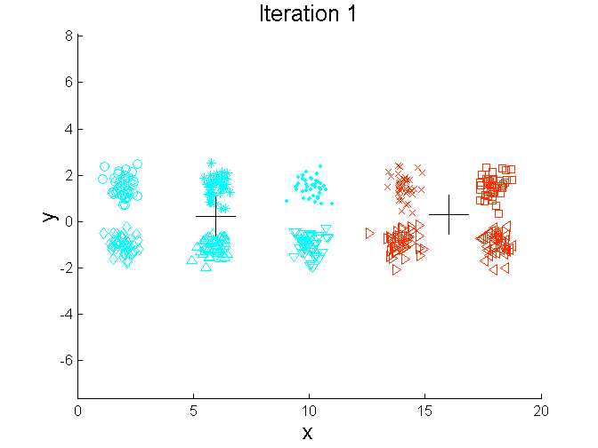
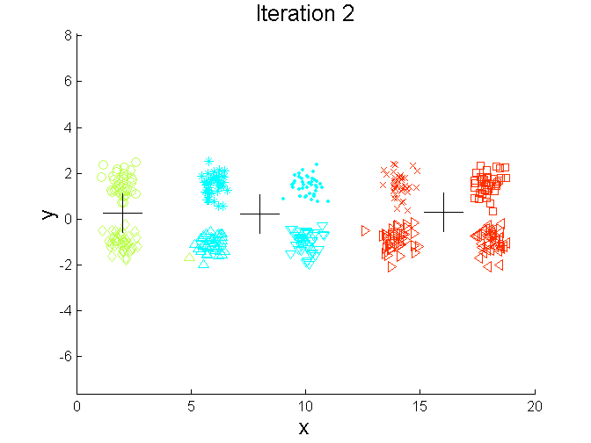
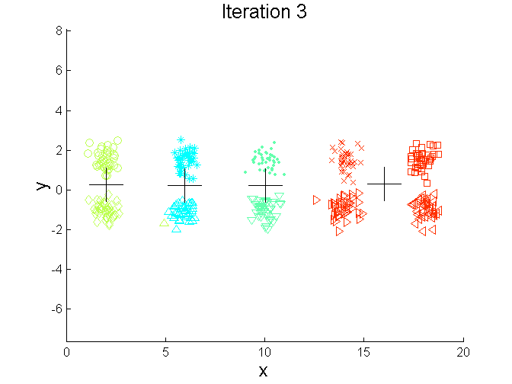
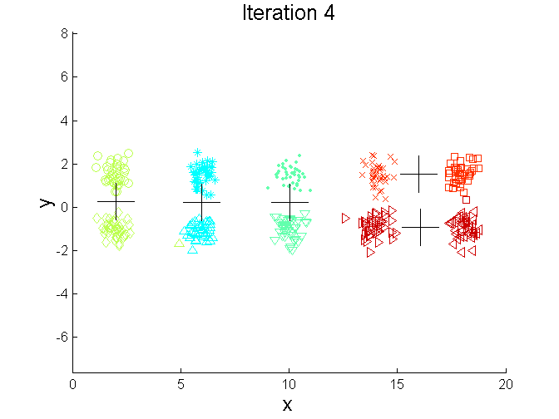
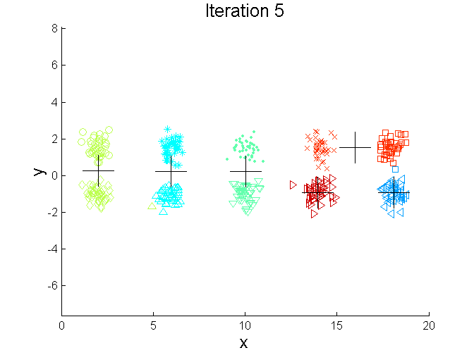
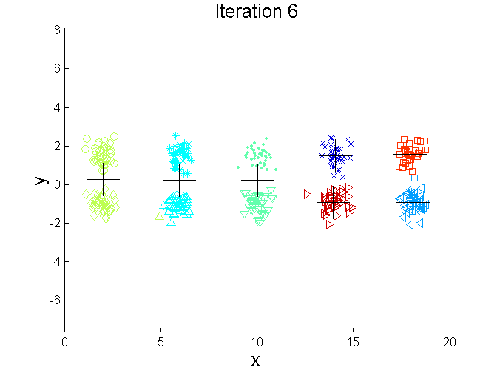
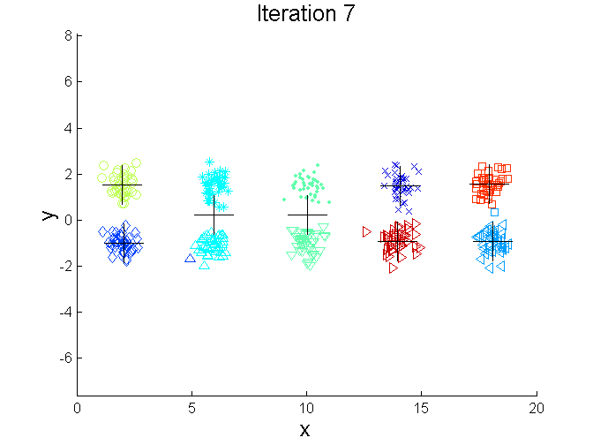
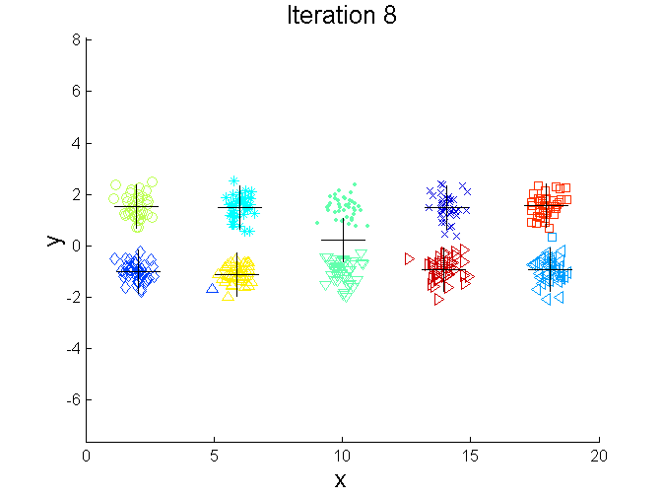
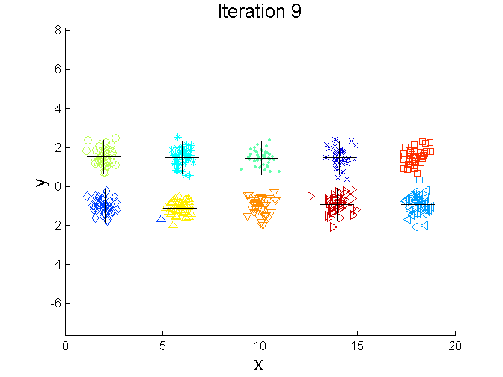
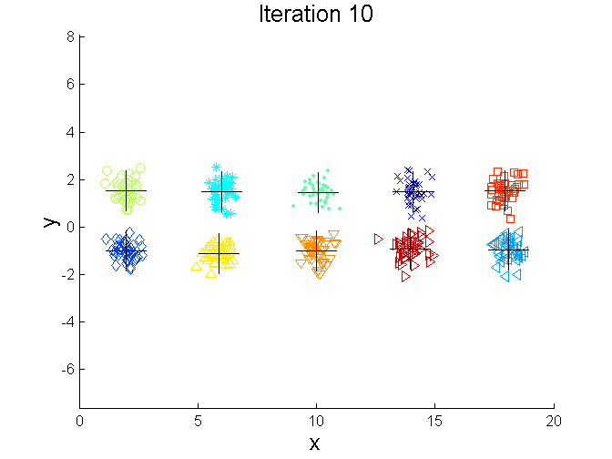
Bisecting K-means Example

Slide 50
Comments on the K-Means Method
Strength: Relatively efficient: O(tkn), where n is # objects, k is # clusters, and t is # iterations. Normally, k, t << n.
    Comparing: PAM: O(k(n-k)² ), CLARA: O(ks² + k(n-k))
Comment: Often terminates at a local optimum. The global optimum may be found using techniques such as: deterministic annealing and genetic algorithms
Weakness
  Applicable only when mean is defined, then what about categorical data?
  Need to specify k, the number of clusters, in advance
  Unable to handle noisy data and outliers
  Not suitable to discover clusters with non-convex shapes

